Slide 1

Personalizing the Study of Personality and Health
Emorie D Beck, PhD
Northwestern University Feinberg School of Medicine

Slide 2
Extraversion
Agreeableness
Conscientiousness
Neuroticism
Openness
Nomothetic
e.g., Beck & Jackson, 2020ab, 2021a
Notes:
From its inception, the study of personality has had two broad goals. One, a nomothetic approach, examines the structure of individual differences between people. The most dominant nomothetic model is the Big 5, E, A, C, N, O. The big 5 have become so uniqutous within personality psychology and predict a number of consequential outcomes and show normative patterns of change and development

Slide 3
Idiographic
e.g., Beck & Jackson, 2020ab, 2021a
Notes:
The second, an idiographic approach, asks questions about the structure and development of personality at the level of a single person relative to only him or herself. Despite a small number of studies examining the individual level structure of personality, idiographic studies of personality have been much more limited

Slide 4
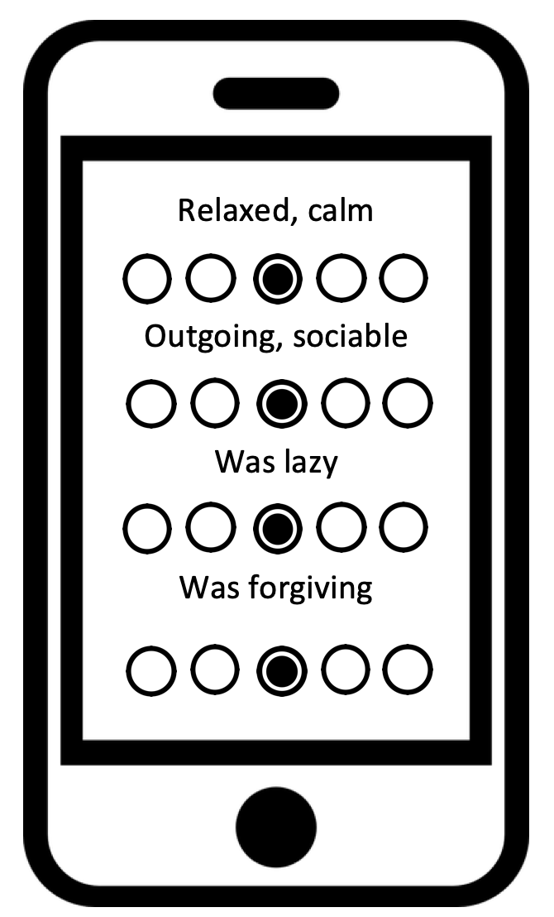
e.g., Beck & Jackson, 2020ab, 2021a
Notes:
In part, this is because to do idiographic research, we need special kinds of data
Historically this was interviews and sessions with clinicians
Today, though we have smartphones that allow to get repeated assessments of individuals

Slide 5
Contemporaneous
Concurrent behaviors: While…
E
A
C
N
O
E
A
C
N
O
time
1 | 4 | 2 | 3 | 2 | 4
2 | 2 | 3 | 4 | 1 | 4
3 | 3 | 3 | 2 | 2 | 4
4 | 3 | 1 | 3 | 2 | 3
5 | 4 | 4 | 3 | 2 | 2
6 | 4 | 1 | 2 | 3 | 4
7 | 2 | 2 | 2 | 2 | 1
8 | 4 | 2 | 3 | 3 | 4
9 | 3 | 2 | 2 | 1 | 2
10 | 4 | 2 | 3 | 3 | 3
11 | 3 | 1 | 3 | 2 | 5
E
0.02
-0.05 | 0.08
0.64 | -0.12 | -0.10
0.26 | -0.27 | 0.43 | 0.07
A
C
N
O
Within Time-Points:
X_{it}←→X_{jt}
e.g., Beck & Jackson, 2020ab, 2021a
Notes:
Experience sampling data are also called multivariate time series data. Essentially, you end up with a data matrix that looks like this, where instead of each row indicating responses from a different individual, the rows indicate momentary observations from a single individual on a numbe rof trait constructs.
Much as how we can look at how trait constructs are related to one another across people, these data allow us to ask how they are related within a person idiographically.

Slide 6
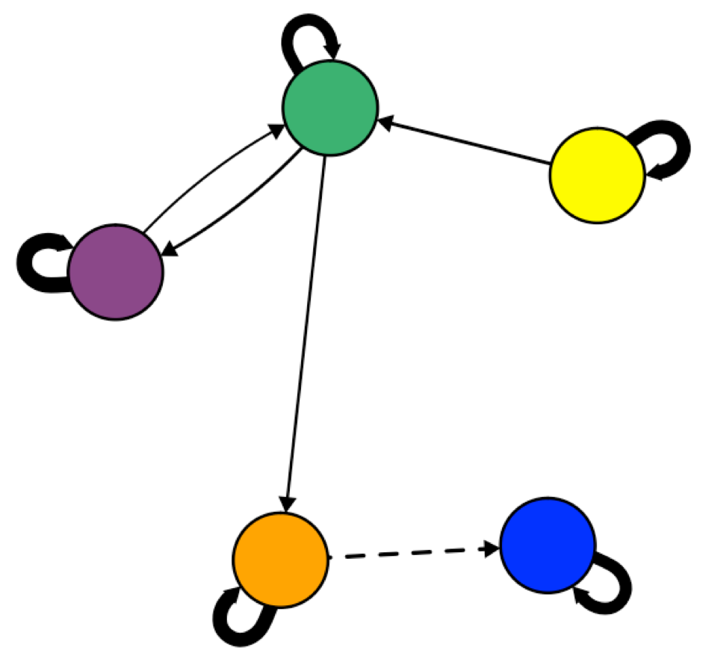
Idiographic
e.g., Beck & Jackson, 2020ab, 2021a
Notes:
But network models have great potential in personality. When coupled with intensive longitudinal data collection, such as that collected using experience sampling or daily diary measures, network models can also be created for individual people, allowing for unique interdependencies among responses.
Such an approach has the advantage of allowing us to model personality closer to the level of a person. In other words, we can model unique relationships among the individuals self-reported observable and unobservable experiences, which may finally allow us to answer the question of whether idiographic assessments of personality do stack up to the power of nomothetic assessments.

Slide 7
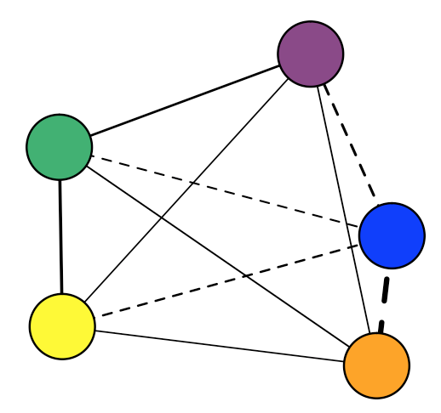
Personalized Interventions
loneliness
energy
Notes:
Moreover, in the study of momentary measures of personality, we can introduce other measures of behavior and assess how those manifestations relate to personality. For example, if we are interested in changing someone’s procrastination, we note a strong, negative connection between energy levels and procrastination such that this individual tends to report low energy while procrastintating.
Noting unique connections like this between target behaviors and personality allows for the use of targeted strategies for changing a behavior

Slide 8
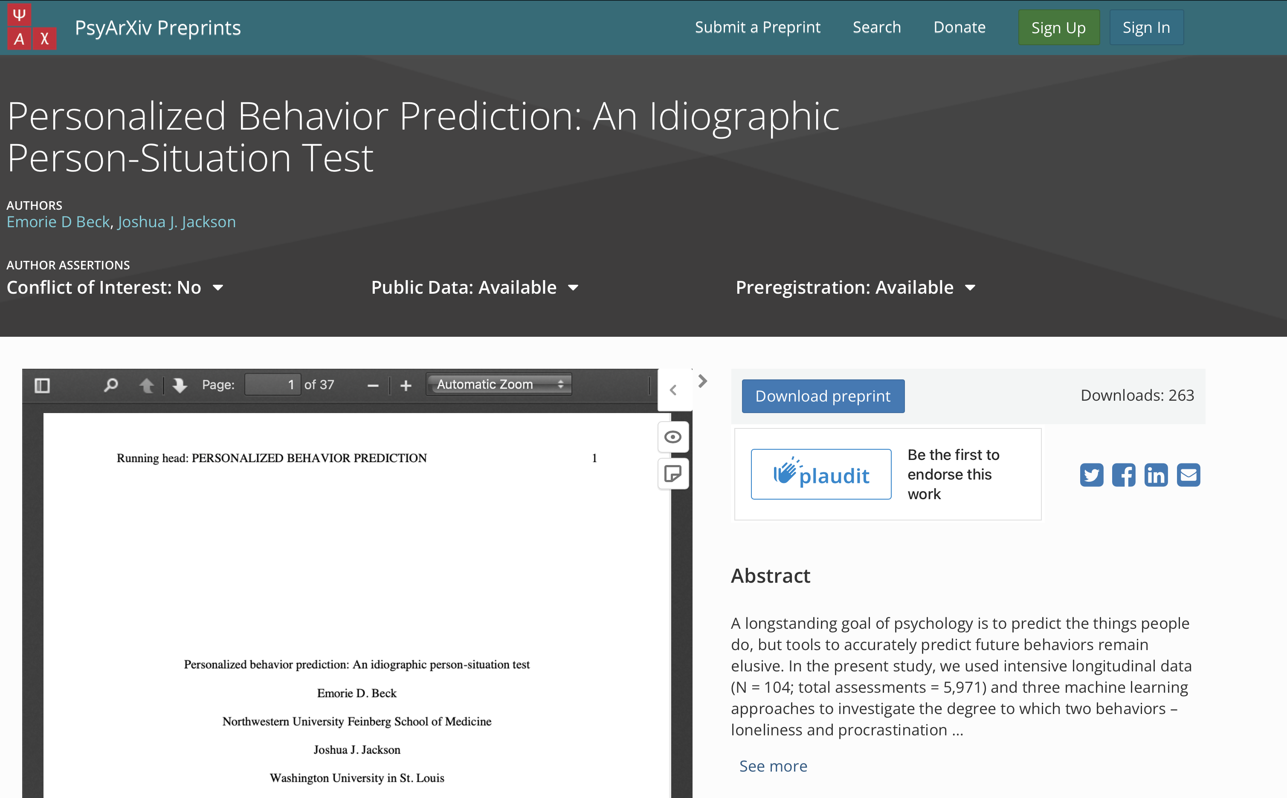

Slide 9
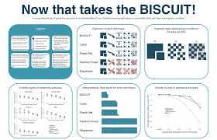
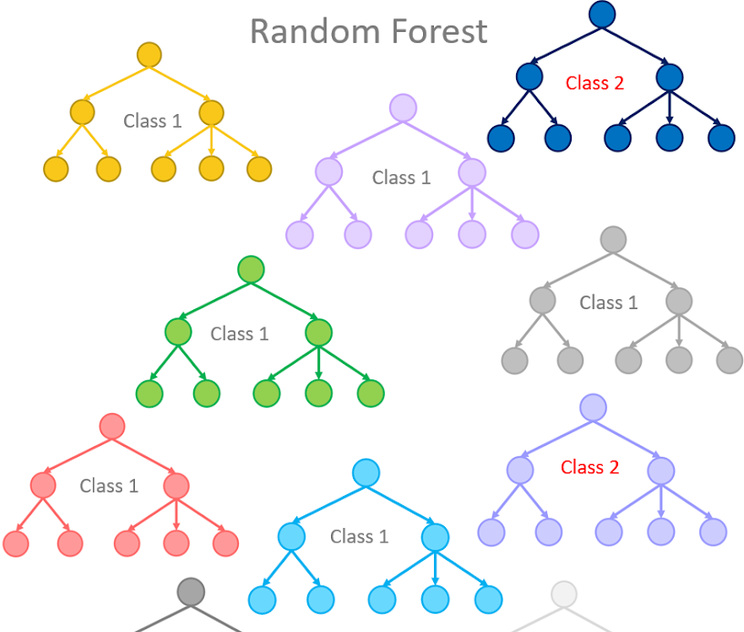
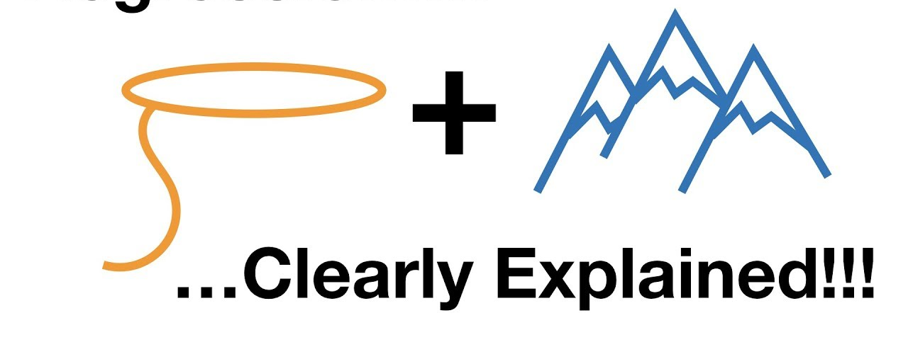
Analytic Plan
- Classification Accuracy
- Area under the receiver operating curve (AUC)
3 machine learning classification methods:
Elastic Net
BISCWIT
Random Forest
Tuning 𝜆 and mixture (10 values each)
Tuning number of items (number possible)
Tuning mtry (# predictors sampled) and min_n (min n to split further)
Rolling origin forecast validation: 1/3 of data as initial set, five obs validation set, skip = 1, which resulted in 10-15 rolling origin “folds.”

Slide 10
To what degree can we predict behavioral and experiential outcomes?
Procrastination
Loneliness
Beck & Jackson, revision submitted

Slide 11
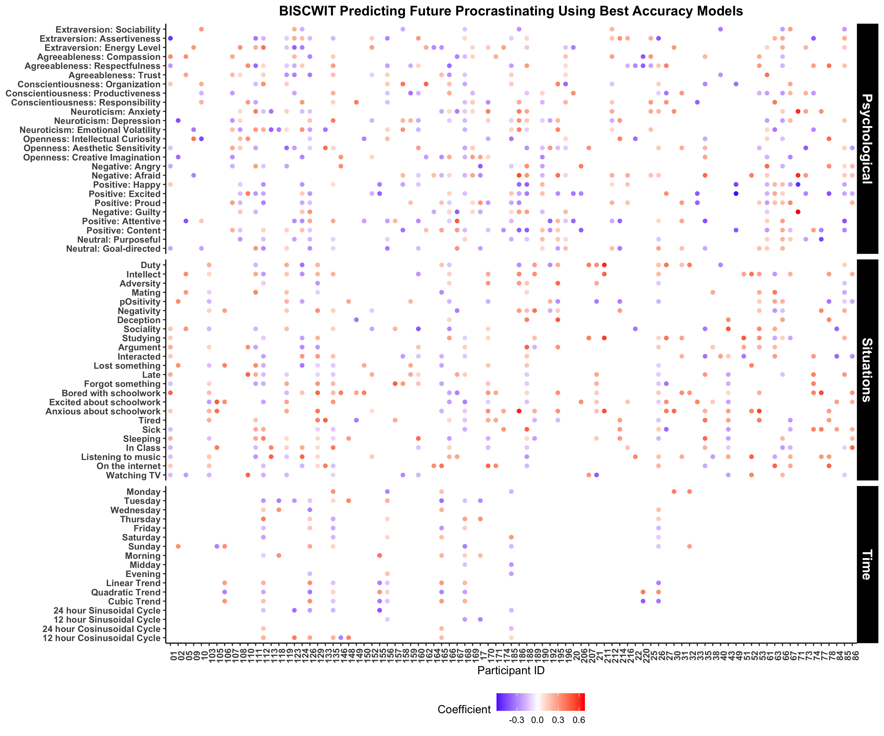
Are there individual differences in which features play the strongest roles?

Slide 12
Are there individual differences in which features play the strongest roles?

Slide 13
Are there individual differences in which features play the strongest roles?

Slide 14
Are there individual differences in which features play the strongest roles?

